Slide 1
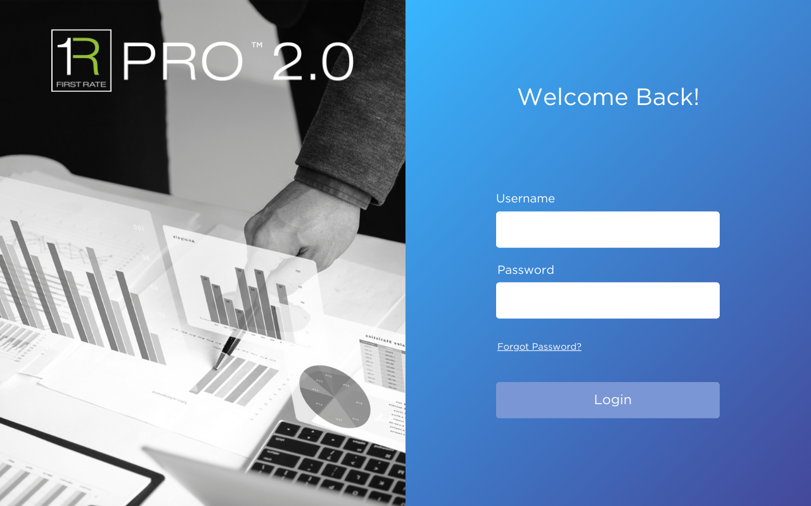
Login Page (left side)
This will be the first page a user sees when accessing the PRO link.
LEFT SIDE
Image and logo used on the left side can be found in the pro2.0_login.zip file.
Font Style: Gotham (regular)

Slide 2
Login Page (right side)
RIGHT SIDE
Gradient filled rectangle shape style and colors:
Linear gradient 135°: #38b6ff, #44489a
Forgot password?
Hyperlinked to open a blank window (this will be a placeholder for password tool)
Font color: #ffffff
Font size: 28
Font color: #ffffff
Font size: 14
Font color: #ffffff
Font size: 11
Font color: #ffffff
Font size: 16
Font Style: Gotham (regular)

Slide 3
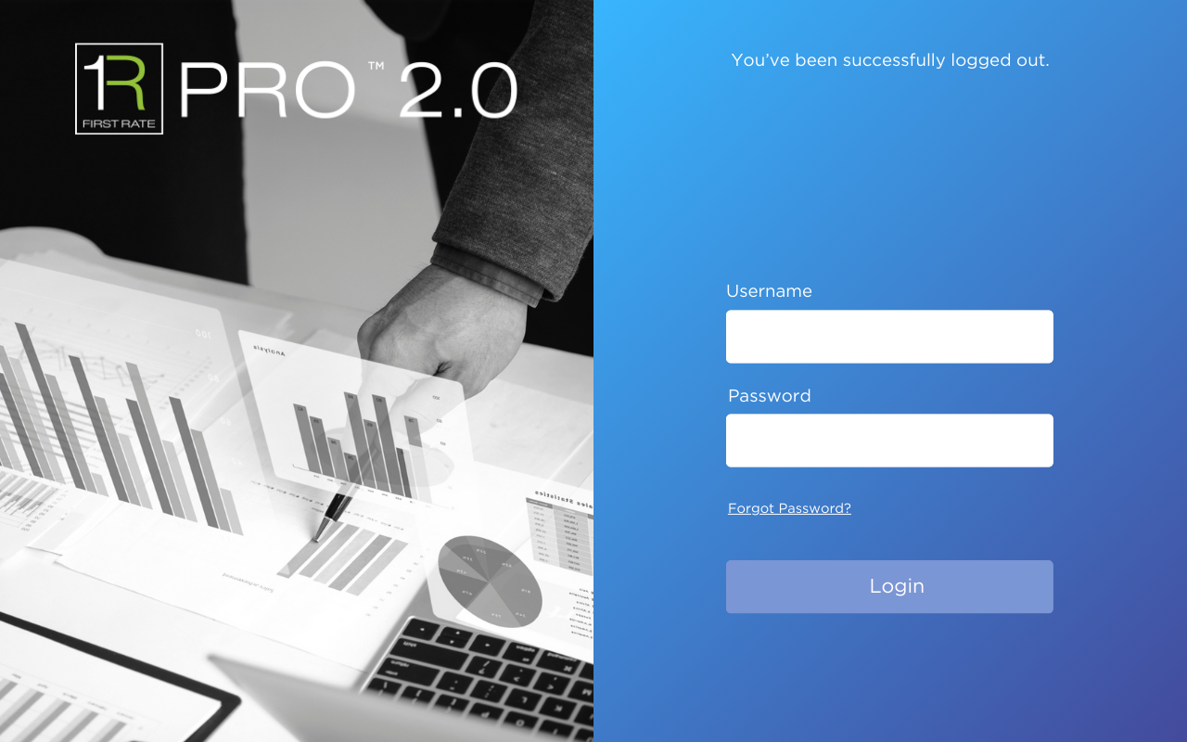
Logout Page
This will be the page shown after a user logs out. The layout is the same as the login page, the only thing that changes is the right side message.
You’ve been successfully logged out.
Font color: #ffffff
Font size: 14
Font Style: Gotham (regular)

Slide 4
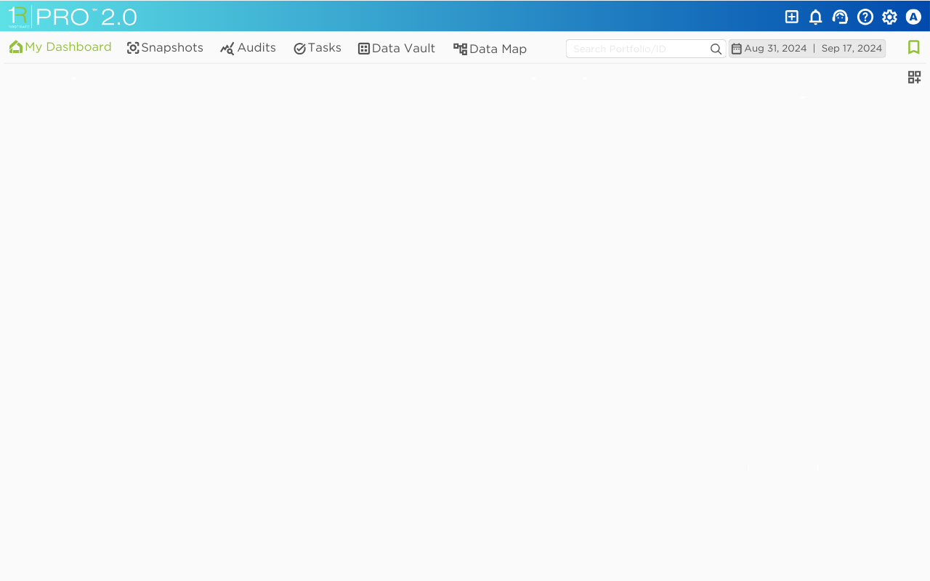
Landing Page
(1) After a user successfully logs in, the landing page should be the “My Dashboard” menu.
For now, no functionality will be added to this page.
(2) Only add the icon shown on this image. SVG is available in the pro2.0_mydashboard_icons.zip file
1
2

Slide 5
Top Header Design
Header Design
(1) Gradient filled rectangle shape style and colors:
Linear gradient 90°: #5de0e6, #004aad
(2) Logo (on the left), image can be found in the pro2.0_topheader.zip file.
(3-8) Icons (on right side), images can be found in the pro2.0_topheader.zip file.
2
1
3
4
5
6
7
8
Font Style: Gotham (regular)

Slide 6
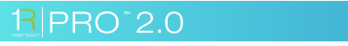
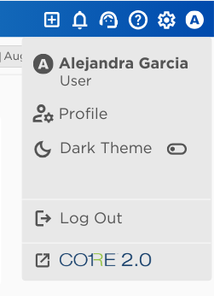
Top Header Functionality
Since the purpose of this story is to create a shell of the UI, we will not be adding functionality yet to every header icon except for some basic functions to the User icon.
Header Functionality
(1) First Rate Logo: clicking on the logo should take user back to the “My Dashboard” menu.
(2) User icon:
Hovering over the icon will display hover text “User Account”
Clicking on the icon will open a pop-up menu, as shown on this image.
For now, only add functionality to the “Log Out” option, clicking on that should successfully log out the user and take them to the log out page previously shown.
Clicking outside of the pop-up menu will close the menu.
(3-8) Icon and logo images can be found in the pro2.0_usericonmenu.zip file.
1
2
Font Size: 13.5 (Bold)
Font Color: #545454
Font Size: 12.5
Font Color: #545454
3
Font Size: 13.5
Font Color: #545454
4
Fill Color: #e8e8e8
5
6
Line Color: #fafafa
7
8
9
Font Style: Gotham (regular)

Slide 7

Horizontal Navigation Menu Design
The navigation menu will be a horizontal menu.
Navigation Menu Design
The navigation menu will include 6 menus, a portfolio group selection bar, a date range bar and a bookmark icon.
Nav icon images can be found in the pro2.0_navmenuicons.zip file.
(1) Menu will be highlighted in bright green when selected.
(2) Portfolio Search Bar
Add basic search bar as a placeholder, this will not be functional for this story.
(3) Date Range
Date range should always be populated.
First time signing in: Set From date=last day of prior month, Set To date = current day (e.g. 08/31/2024 – 09/17/2024)
Not first time signing in: use last login session selection
Functionality of the date range will be further defined with another story.
(4) Bookmark
For now, we only need the icon there without functionality linked to it. This will eventually be a pop-over menu that will store the user’s last 5 recently accessed areas (breadcrumbs) and shortcuts.
1
2
3
4
Font Size: 12.15
Font Color for selected menu: #93c139
(use this color only when menu is selected)
Font Color for NOT selected menu: #545454
Line Color: #e8e8e8
Font Style: Gotham (regular)

Slide 8
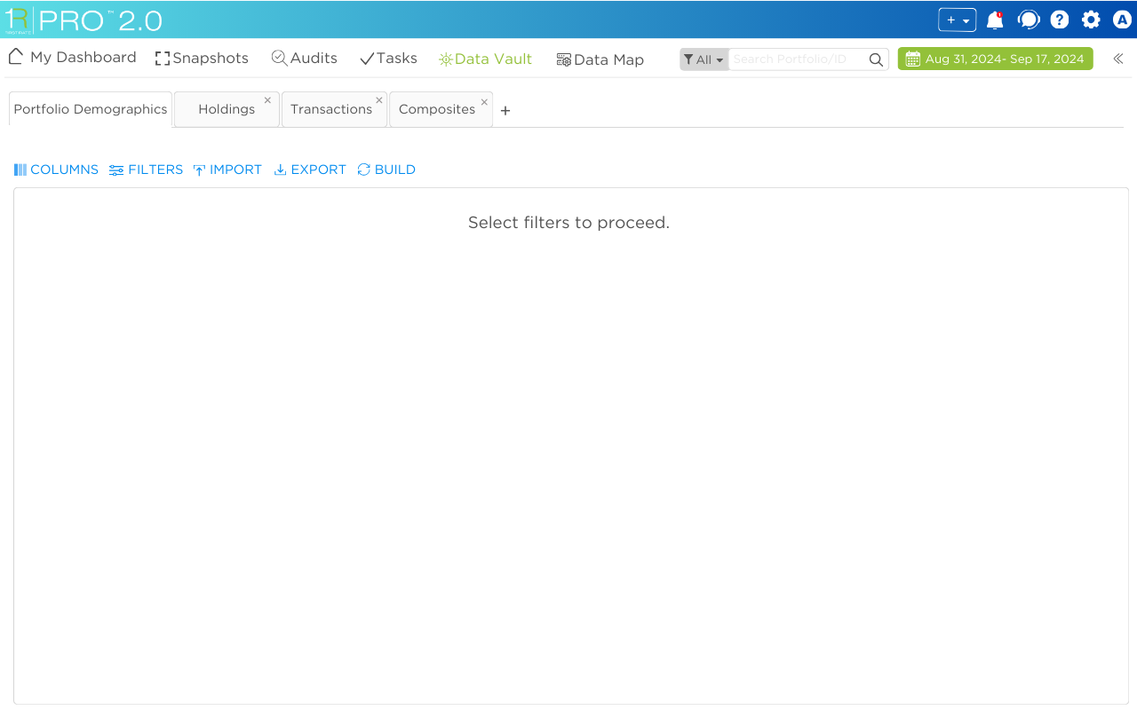
Data Vault – Landing Page
The Data Vault menu will be the only page that will be created for now with this story since it will be needed as we are prototyping the table grid component. The rest of the menus can just load as blank pages or leave unfunctional.
This menu is meant to replace the PRO 1.0 screen editors and MRE tables.
Data Vault Design
Upon clicking on the Data Vault menu, the page will load a tabbed menu that will include the 4 tabs shown by default.
Tabbed Menu
User can close each tab by clicking on the “x” but must leave the first one open. The first tab should not have the “x” as an option.
Tabs should have the ability to reorder by dragging and dropping left to right, right to left.
The “+” indicates a user can add a new tab. For purposes of this “shell” story, the “+” will remain not functional until we have additional design/requirements around that.
The color of tabs that are not selected should be set to the light gray. The selected tab should be shown in white.
If user goes from one tab to another, leave the previous tab session as is, do not refresh. This will allow user to toggle between tabs and not have to re-select options. Session should only be cleared/reset if moving to another menu (e.g., Data Vault to Tasks).
Page components
Display the 5 components shown (Columns, Filters, Import, Export, Build). For purposes of this shell, they can be left non-functional since this type of functionality is currently being prototyped. Once we have a better understanding of what the capabilities are, we will define the functionality in detail with another story.
The “landing message” when no filters are selected should be “Select filters to proceed.”
Icons for each option can be found in the pro2.0_datavault_tabicons.zip file.
Font Size: 11
Font Color: #545454
Tab Color : Fill #fafafa , Outline #d6d6d6 (use these colors only when tab is NOT selected)
Font Size: 15.6
Font Color: #545454
Font Size: 11
Font Color: #545454
Tab Color : Fill #ffffff , Outline #d6d6d6 (use these colors only when tab is selected)
Line Color: #e8e8e8
Font Size: 11
Font Color: #008bef
Font Size: 14
Font Color: #545454
Font Style: Gotham (regular)
Notes:
Can we do an “Inline View” in this phase? Visual Studio allows you to do that when comparing two tabs.

Slide 9
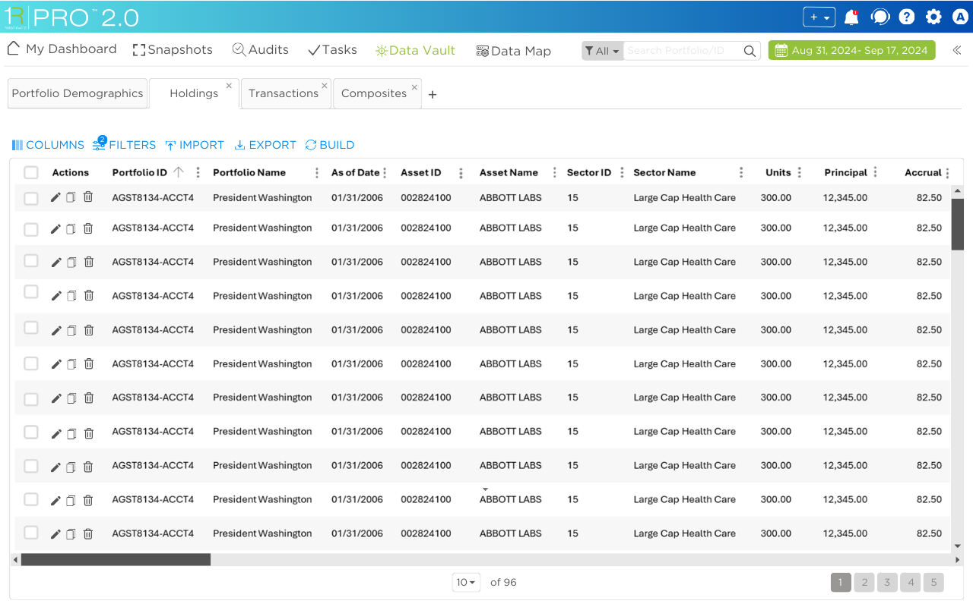
Data Vault – Holdings Tab
The table grid editor is being prototyped with another story. Once we determine which tool we are going to use for it, we can refine the design of the table further. Added this as an example of what the initial design would look like. The functional requirements are currently part of the prototype story.

